Slide 1
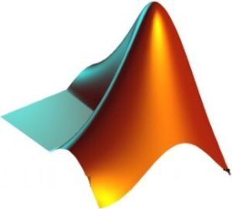
SIMPLIFIED CURVE FITTING
EEE 212 Project
BY
Anindya Kishore Choudhury 1906081
Md. Liton Ali 1906080

Slide 2
STATEMENT OF THE TOPIC
To write a code that will segment a particular curve and find easy equation for that portion.

Slide 3
OUR APPROACH TO THE PROBLEM
Smoothing the image points.
Finding out the peaks and crests.
Dividing the image points into several segment through the peaks and crests.
Comparing these segments with some common equations.
Selecting the equation that fits best to each of the segments.

Slide 4
Logic Flow
Read Image and Convert to Binary
(Run Script)
Use Image Read Intensity Slider
to read the image optimally
Use the Peak Spacer Value
(RUN Script)
Call the function Smoothsc
Print the output using showans function
(Run Script)
Call the function findpeaks
the function bestfitcurve will call the
function ratreg, circularreg, and expreg
Call the function bestfitcurve

Slide 5
EQUATIONS USED TO FIT THE CURVE
1. Linear equation: y=mx+c
2. Second degree polynomial : y=ax²+bx+c
3. Third degree polynomial: y=ax³+bx²+cx+d
4. Circular equation: x²+y²+2gx+2fy+c=0
5. Rational equation : y = (x+A)/(Bx+C)
6. Exponential equation :y = e^{ax+b}

Slide 6
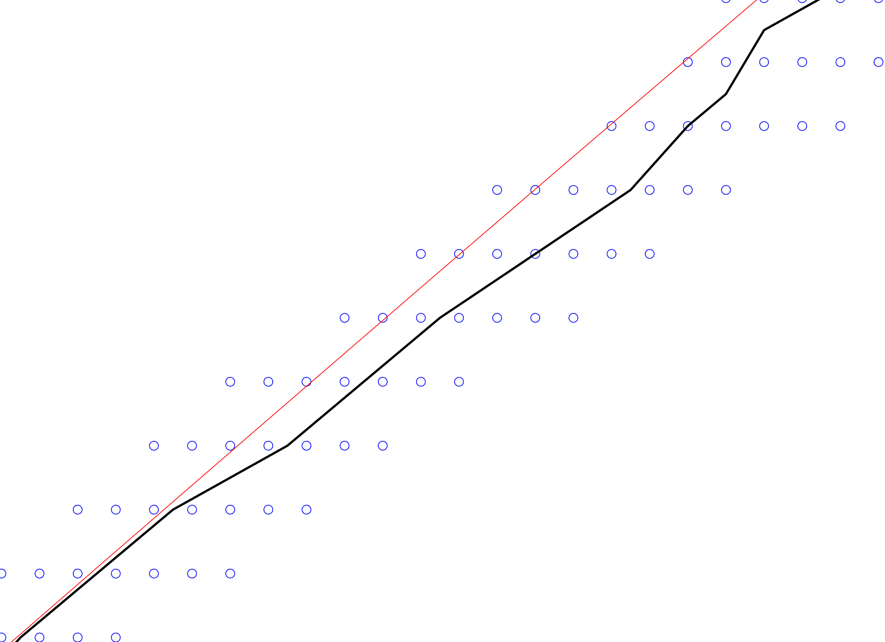
SMOOTHING
Why smoothing was necessary?
Smoothened Curve
Fitted Curve
Input Image Pixels
Figure: A Zoomed in Version of the Output

Slide 7
PEAKS AND CRESTS
Peak:- A peak is the point whose ordinate is greater than that of the adjacent points, mathematically f(x)>f(x-h) & f(x)>f(x+h).
Crest:- A crest is the point whose ordinate is smaller than that of the adjacent points, mathematically f(x)<f(x-h) & f(x)<f(x+h).

Slide 8
SEGMENTATION
The given curve was segmented through the peaks and crests.
Then we tried to fit an equation for each segment.

Slide 9
Demonstration

Slide 10
LIMITATIONS OF THE CODE
The fitted curve is not very accurate at the peak points;
Also, the curve is not very accurate to find out any vertical or horizontal line present in the image;
There is no intelligent equation matching for faster equation match;
The equation library is not too big;
The advanced image processing is not done to remove the noise from the input picture.

Slide 11
FOR FUTURE WORK
A more sensitive algorithm to find out the bending and flat lines in the curve accurately;
New approach in segmentation to eliminate the peak problems.
Comparing with more equations;
Advanced Image Processing to remove the noise from the picture;
Implement the project in case of autonomous driving vehicle;

Slide 12

Misc. Discussion
Question and Answer Session

